Slide 1
Remote Metal Detection System
By Jay Wei
Prof. Jiang
Ens491

Slide 2

Project Description
Underground metal detection today either for mine detection or treasure hunt involved close-by human intervention.
While the modern metal detector is already well design, it required direct human involvement.
This is rather dangerous and time consuming

Slide 3
Objective
The purpose of this project is to develop an metal detection system that allows operator to perform metal detection remotely.

Slide 4
Description of system operation
The system will mainly consist of a metal detection circuit and a camera-based tracking software
The detection circuit will continuously send signal to an remote PC via RF.
The software will continuously track the position of the detector through its camera module. At same time, analyze the signal received to determine the existence of underground metal.
Upon founding of the metal, the software will capture the location of the detector at that specific moment.

Slide 5
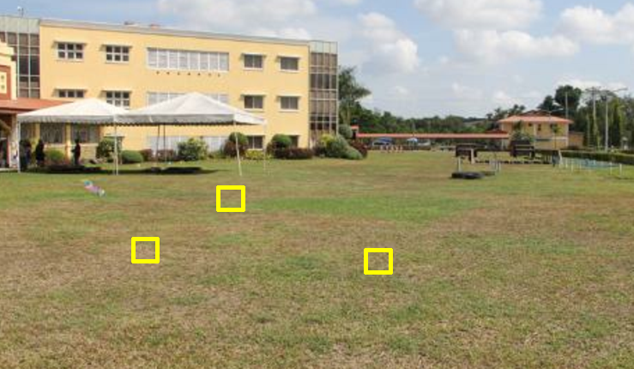
Example of the resulting image
The yellow box indicates the location at where the detector has detected metal.

Slide 6
Specifications
The system shall operate when metal detector is up to 30 feet from the operator
The metal detector will have detection depth up to 10cm below ground
The metal object to be detected shall be bigger than size of a quarter
The software shall be able to capture the location of metal detector upon detection of metal with < 1 second delay.

Slide 7
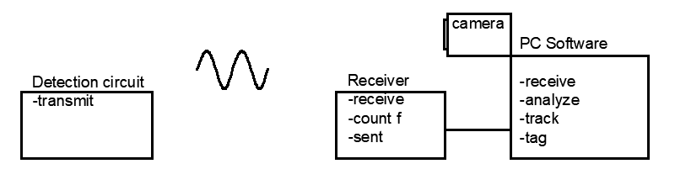
System Overview
Detection Circuit utilizes LC tank to continuously transmitting a signal
Frequency of signal to be received and measured by an remote receiver
The receiver will send frequency value to the PC via serial communication port for further processing

Slide 8
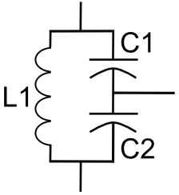
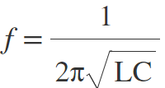
Technical Detail - Metal Detection Circuit
Circuit on the left shows a typical LC tank circuit.
The current discharged from the serial capacitors flows through the inductor, when the capacitor is fully discharged, the inductor begin to discharge to maintain the current flow, thus charging the capacitor. Process repeats resulting in oscillation
Let C1=C2=0.1uF =>C = 0.05uF
L1 = 1mH
f=1/(2*3.14*sqrt(0.05*10^-6*10^-3))
= 22kHz (base frequency)

Slide 9

Technical Detail - Metal Detection Circuit continuous
Metal influence frequency
Inductance equation for coil
Since relative permeability of metal > 1, Inductance increase as coil approach metal. => decrease in frequency
So the goal is to detect the change in frequency as it indicates the existence of nearby metal
Coil Data: 24AWG, 50turn around a 10cm loop
L = 0.8mH

Slide 10
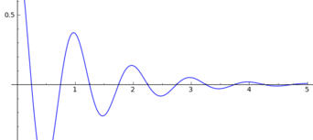
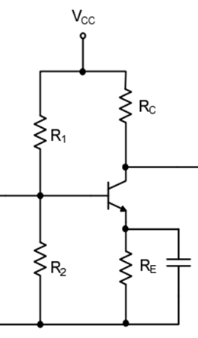
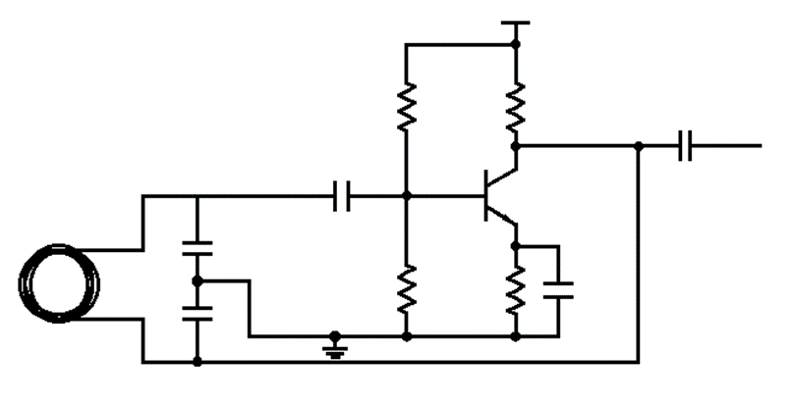
Technical Detail - Metal Detection Circuit continuous
In real life, oscillation dies out almost instantaneously
BJT Amplifier added to continuously add gain to the oscillation
Combination of LC circuit and Amplifier become a Colpitts Oscillator
Common emitter amplifier
Colpitts Oscillator

Slide 11
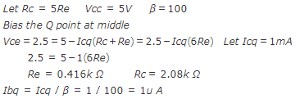
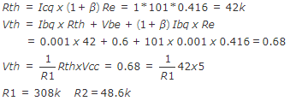
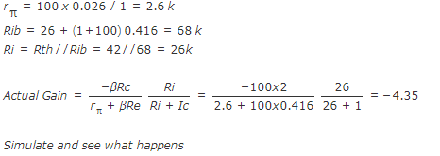
Technical Detail - Metal Detection Circuit continuous - BJT amplifier design
For Colpitts oscillator to start, Voltage gain must be greater than C2/C1 of the LC tank.
Design a common emitter with gain of 5.
Rc = 400 Ω , Re= 2000 Ω
R1 = 310k Ω , R2 = 49k Ω
Actual gain would be approximately -4.35

Slide 12
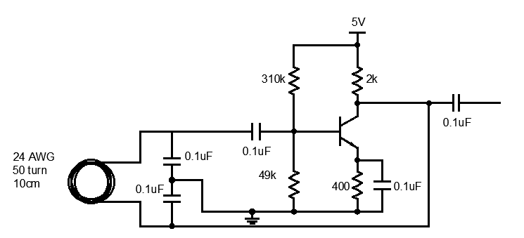
Technical Detail - Metal Detection Circuit continuous
Complete metal detection circuit

Slide 13
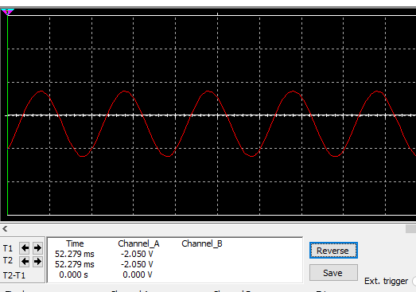
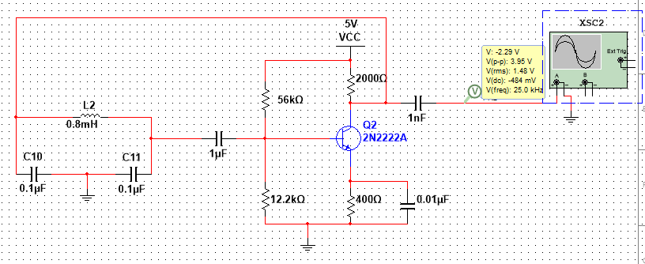
Technical Detail - Metal Detection Circuit continuous
Simulation

Slide 14
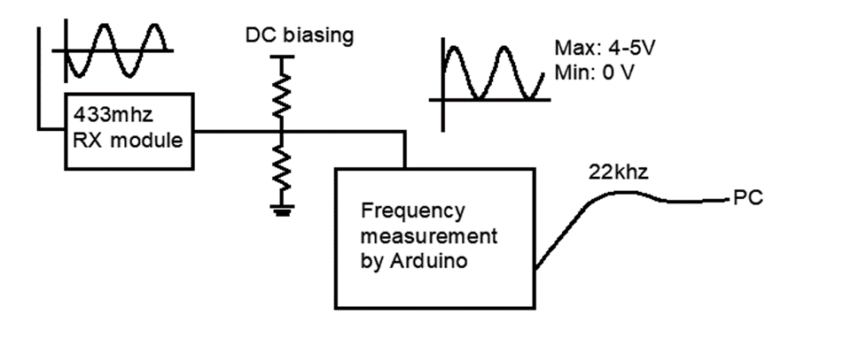
Technical Detail -Frequency Receiver and counter
Signal to be received by RF receiver module.
DC bias added to make the signal digitally measurable by Arduino digital pin.
Amount of DC biasing to be determined based on actual received signal

Slide 15
Technical Detail -Arduino Frequency Measurement
Coding Approach :
Arduino UNO ATMega328 microcontroller equipped with 3 timer/counter registers (TCCR)
TCCR can be configured to received external clock source which can be our signal
To count the frequency, Output Comparison register (OCR) can be configured to decrement by 1 every clock cycle (cycle of our signal).
Then by measuring the time interval between each time the OCR reaches 0, we can calculate the frequency by dividing max number in OCR (255 for 8 bit) by time interval.
FrequencyCounter library

Slide 16
Technical Detail -Object Tracking
Coding Approach:
The goal is to track the metal detector on a camera and mark its location accordingly
To trigger the marking of the detector’s current location, we set a threshold for the frequency. When frequency reach out of the threshold, the location of the detector at that specific moment is captured.
Background Subtraction Technique
In computer vision, image/frame is represented by matrix (size to be determined by pixels).
Each element of matrix hold (3) 8 bit values (0-255) each represents Red, Green , Blue. ie (255,255,255) represent white.
Computer first capture frame1 as background, and then frame2 with object is introduced.
Subtracting Frame2 by Frame1 will produce a Difference-Frame
Difference-Frame holds the information about the location of the object
By continuously subtracting new frame by frame1 as camera is recoding, object can be tracked
OpenCV library

Slide 17
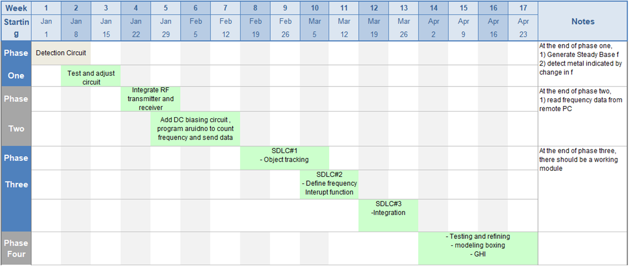
Project Scheduling

Slide 18
Cost Analysis – Budget
Estimation based on pricing from AMAZON
Major purchases:
Arduino UNO R3 18.90
433 mhz transmitter and receiver 5.00
197’ 24AWG magnet wire 7.45
Minor purchases:
Resistor, Capacitor, Transistor, AA battery 10.00
Total 41.35

Slide 19
Risk Analysis and Mitigation
The signal received by receiver will not be exactly the same as the signal transmitted.
However, adjustment to circuit and program can be made to adopt the deviation.
If the deviation is too severe, then it might be more practical to measure the frequency at the detection side using additional microcontroller and transmit only frequency value instead of entire signal.

Slide 20
Deliverable
Upon completion of project, live demo will be given in the classroom.
A completed project will consist of
(1) metal detector with transmitter
(1) Arduino with receiver circuit (+ frequency counter program)
(1) Laptop connected to Arduino (+ object tracking program via webCam)
A successfully project has to satisfy all functional specification listed in slide 6 and produce the resulting image as shown in slide 5

